Slide 1

Predictive Model For Customer Churn
Syed Jawad Hussain Shah
Doctoral Student
Department of Computer Science and Electrical Engineering
University of Missouri-Kansas City

Slide 2
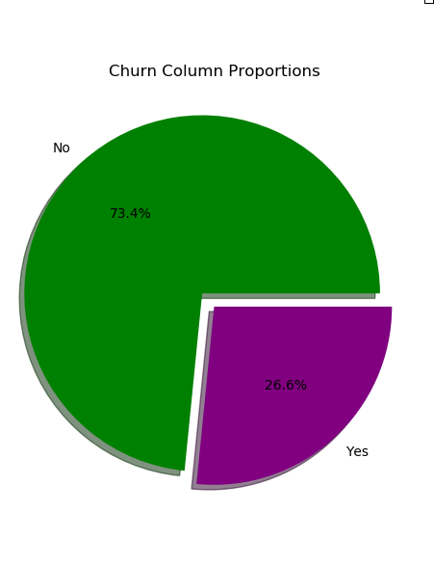
Data Insight
Telcom Customer Churn Data from Kaggle
Link to Data
Data contains 7043 rows and 21 columns
20 variable columns
1 target column containing two class labels, “No” and “Yes”
Imbalanced data
73.4% “No” values and 26.6 % “Yes” values for the target column Churn

Slide 3
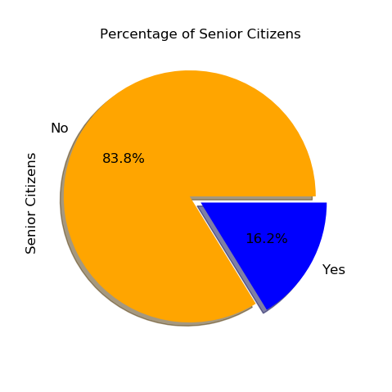
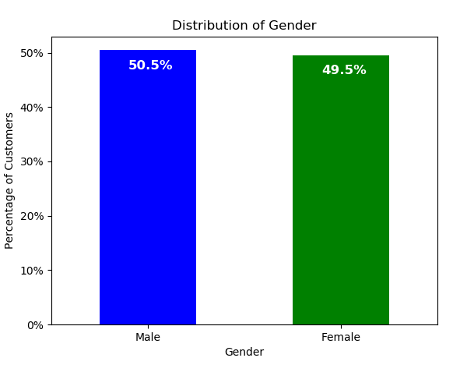
Data Insight
No obvious outliers in the Data
50.5 % of the customer in data set are male and 49.5% are female
Also only about 16.2 % are senior citizens, while 83.8 % of customer are younger people
48 % of customers have partner and 52% don’t have it
30 % of customers have dependents and 70 % haven't

Slide 4
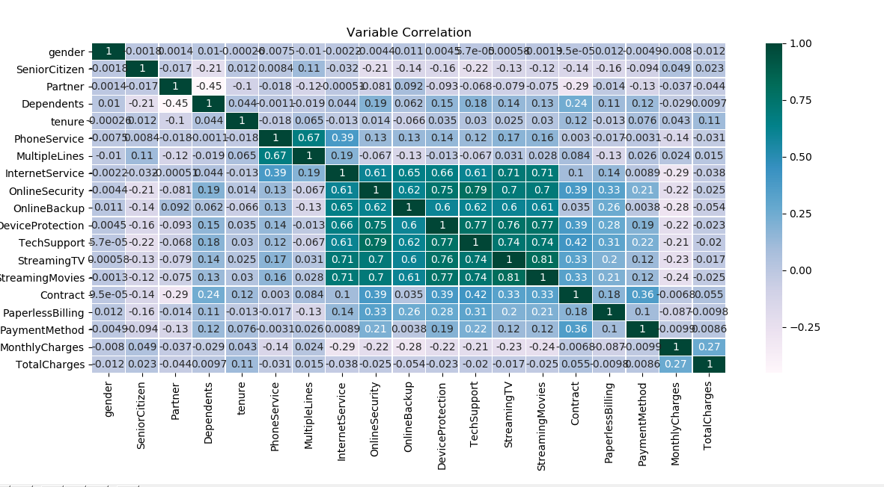
Correlation between variables
OnlineSecurity, OnlineBackup, DeviceProtection, TechSupport, StreamingTV, StreamingMovies have strong correlations between each other
MultipleLines and PhoneService also have strong correlation.

Slide 5
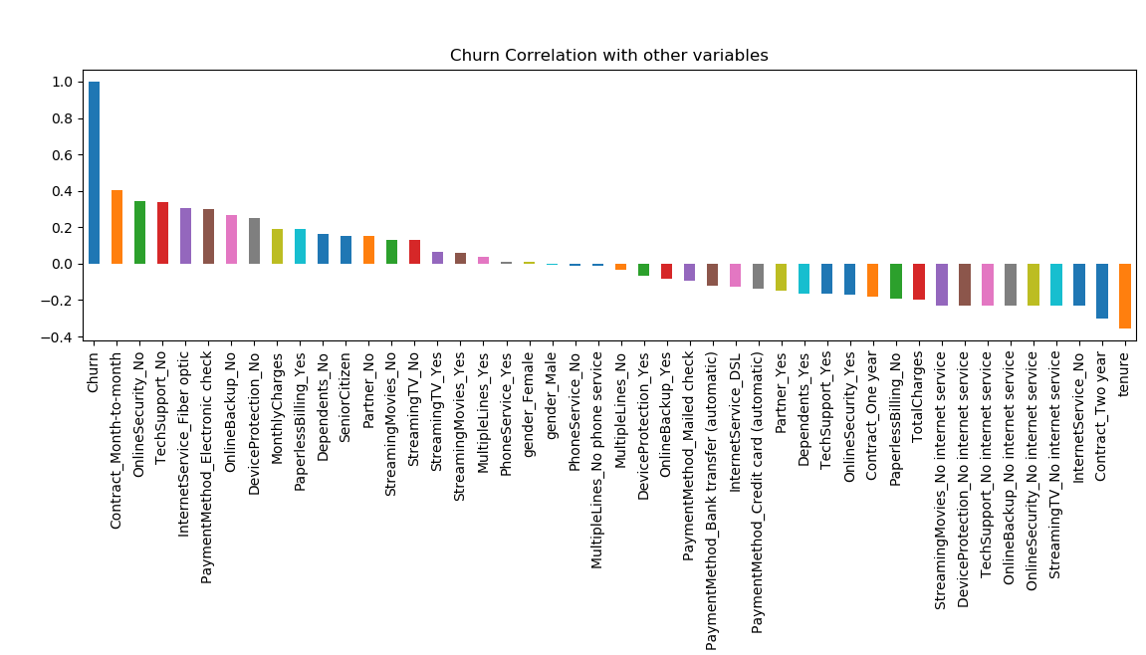
Correlation of variables with Churn (target Column)
Month to month contract, No online security and tech support, fiber optic internet service, no online backup, no device protection, and monthly charges are positively correlated with churn.
Tenure, two year contracts and no internet service are negatively correlated with churn
Gender and Phone service seem to have no impact on Churn, because the correlation is pretty low

Slide 6
Data preprocessing
Conversion of the datatype of TotalCharges column from object to float
11 rows were dropped that contained missing value for TotalCharges column
Replacement of “Yes” with 1 and “No” with 0, for the values of Churn column
Dropped the column CustomerID (random value), gender, and PhoneService (because of very low correlation with Churn column).
Initially the values of “No Phone service” and “No Internet Service” were changed to “No” for some columns
Then the values of categorical variables were changed to numerical values
Dataset was split into training and testing set using stratified cross validation, to ensure each set contains some samples from both the class labels

Slide 7
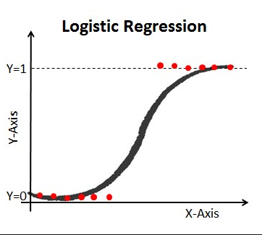
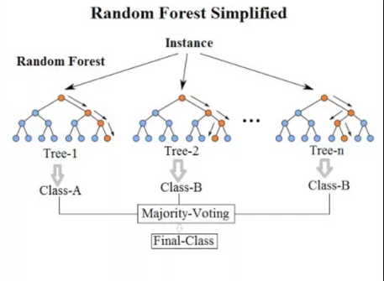
Predictive Models
The goal is to develop a predictive model that can perform binary classification
Models:
Logistic regression
Random forest
Supervised learning with two class binary classification on Churn Column
Stratified Cross-Validation: to ensure that samples percentage of both classes are preserved in training and testing datasets

Slide 8


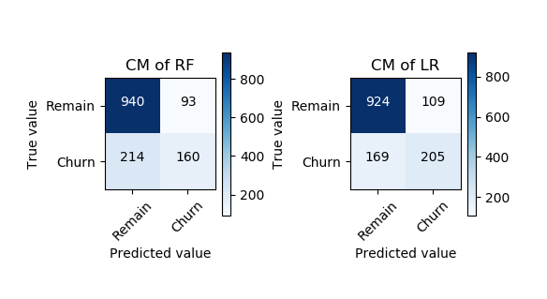
Models Performance
Random Forest:
Among 374 (160+214) actual Churn values(“Yes” value in data) the model predicted 253(160+93) values
Among 1,033 (940+93) actual Remain values(“No” value in data) the model predicted 1154(940+214) values to be remain
Precision= 160/(160+93) = 0.632411
Recall=160/(160+214)= 0.427808
Accuracy = ((940+160)/(940+93+214+160))*100=78.18%
Logistic regression:
Among 374 (169+205) actual Churn values(“Yes” value in data) the model predicted 314(205+109) values
Among 1,033 (924+109) actual Remain values(“No” value in data) the model predicted 1093(924+169)values to be remain
Precision= 205/(205+109) = 0.652866
Recall=205/(205+169)= 0.548128
Accuracy = ((924+205)/(924+109+169+205))*100=80.24%

Slide 9
Important Factors and Findings
Contract: Churn is decreased with 2 year contract and Tenure with 2 year contract has strong negative correlation to Churn. However, month-to-month has positive impact on churn.
InternetService: DSL service has negative impact on Churn, but surprisingly Fiber optic increases the churn rate
TotalCharges: Impacts the rate of Churn
MonthlyCharges: Positively related to Churn
SeniorCitzen: Senior citizen (“Yes” values) are likely to Churn

Slide 10
References
https://medium.com/@sebastiannorena/finding-correlation-between-many-variables-multidimensional-dataset-with-python-5deb3f39ffb3
https://www.dataschool.io/simple-guide-to-confusion-matrix-terminology/
https://stackoverflow.com/questions/43075709/how-to-create-subplot-using-matplotlib-in-python
https://pandas.pydata.org/pandas-docs/stable/reference/api/pandas.get_dummies.html
https://stackoverflow.com/questions/35595766/matplotlib-line-magic-causes-syntaxerror-in-python-script
https://www.kaggle.com/bandiatindra/telecom-churn-prediction
https://pandas.pydata.org/pandas-docs/stable/user_guide/visualization.html
https://www.kaggle.com/hannahzhaouk/telcom-customer-churn-prediction/notebook

